Slide 1
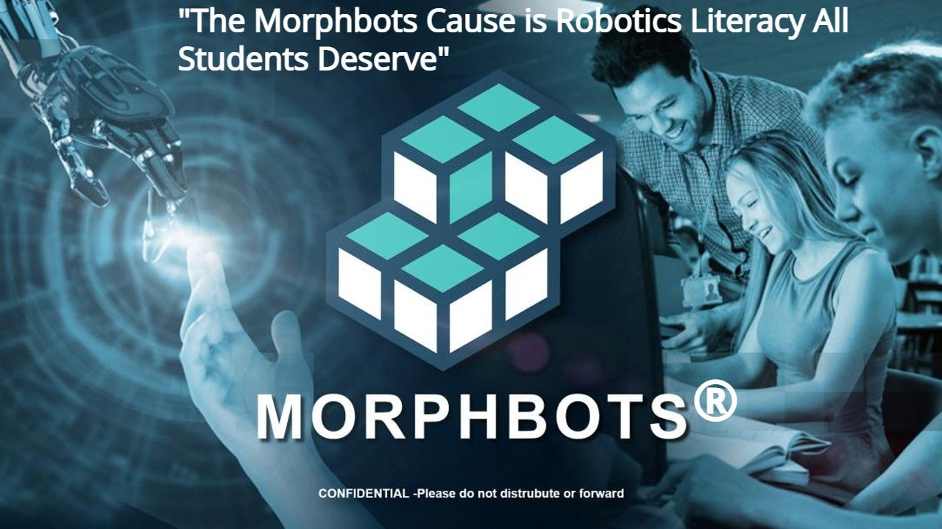
“Making Robotics Literacy the Standard in K12 Education”

Slide 2


PROBLEM: The Future of US Students is Despairing Because They Will Not Qualify for High-Paying STEM Jobs!
Students will not be qualified for the future of work
Millions of unfilled STEM jobs in 2025 because of skill gap
American students are average in math and science compared to other advanced nations

Slide 3
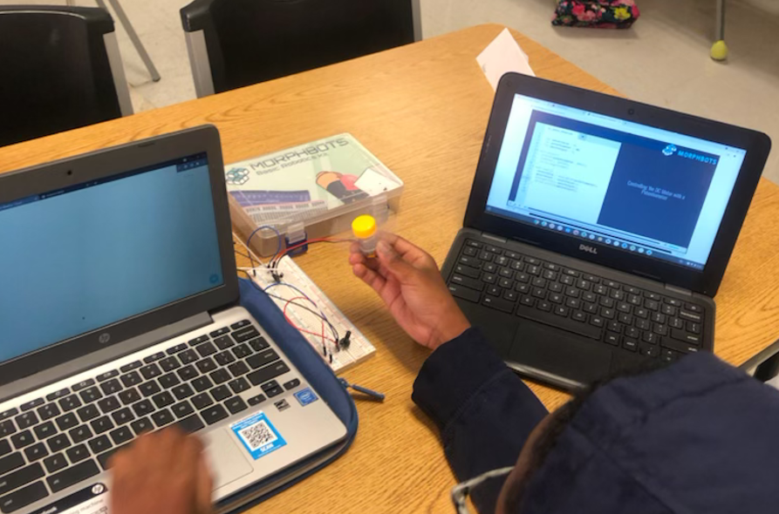
SOLUTION: Make Robotics Education—the Gateway to STEM Learning—Competitive, Cool, and Collaborative!
Capture the student’s imagination with STEM learning
Robotics is the gateway to STEM education
STEM jobs pay 2.5 times more than non-STEM jobs now
Access to robotics education to all kids in the US especially in disadvantaged, low-income areas

Slide 4
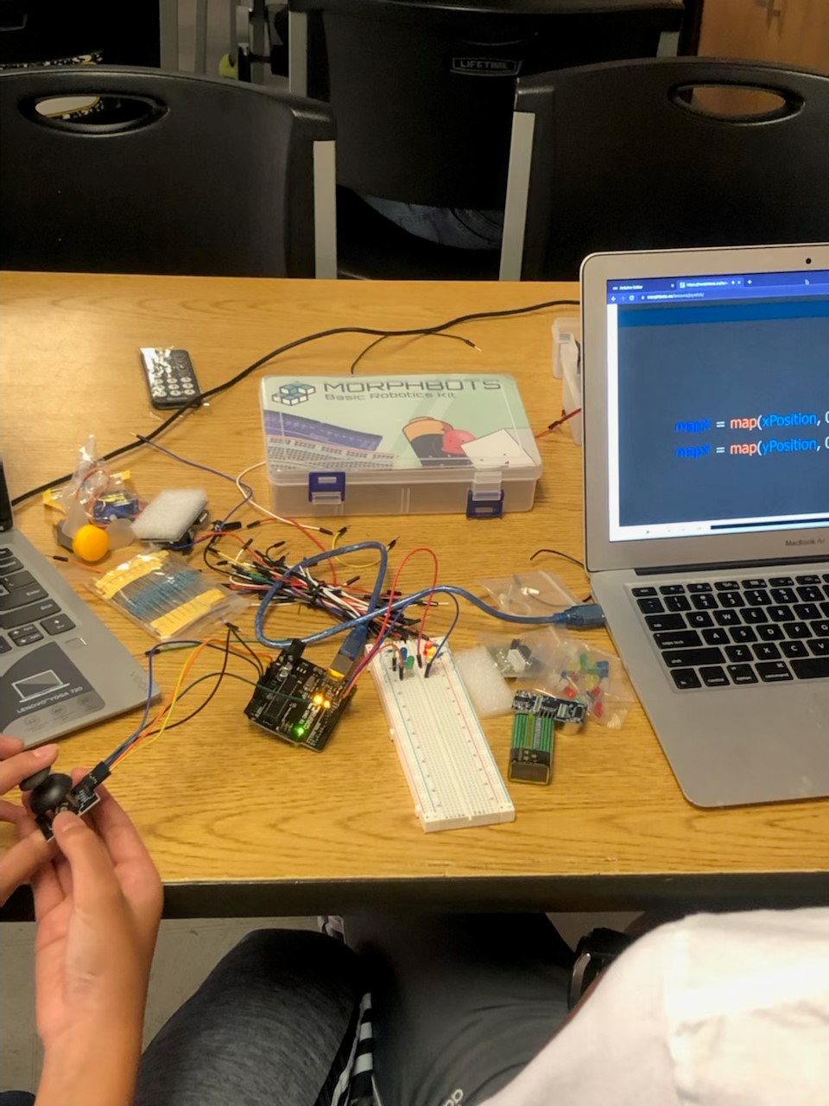
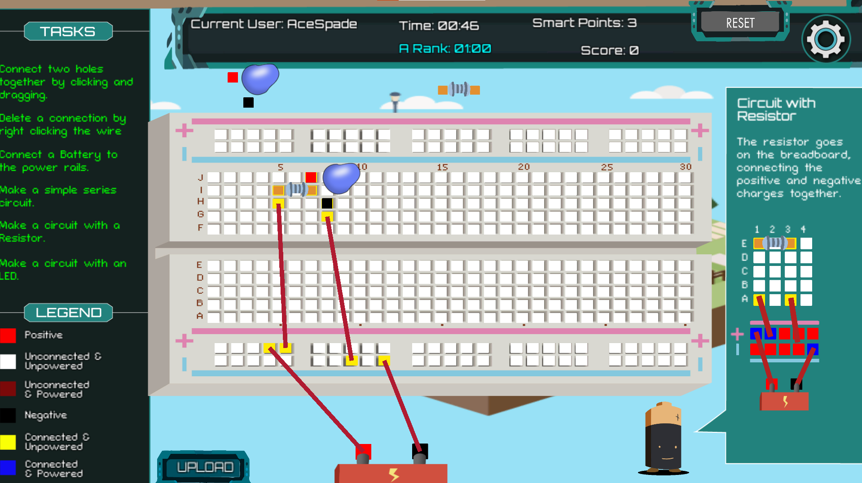
PRODUCT
Morphbots offers a virtual robotics kit in a gamified setting. Students progress to a physical kit where they apply the same principles, they learned in the Breadboard Game.

Slide 5
BUSINESS MODEL
Target Customer: School Districts, Teachers, and Parents
Breadboard Game & 2d Robot Lab, subscription and booking model
Robotics Kit $79.99/student
Target Customer
13,800 public school districts in the US
3.3 million full/part-time K12 teachers in US
Over 63 million parents (children under 18) in US
34 million K12 students in US (4th – 12th grade)
Breadboard Game
(Educational Video Game)
Breadboard Game, $.99(seat)/month
Chromebook compatible – most school have one
2d Robot Lab, $5/hour to rent robot remotely
Intro To Robotics (Physical Robotic Kit with Online Course)
Tailored robotic kit packaged with online course
Teacher dashboard with professional instruction for beginner
Aligned with STEM curriculum standards

Slide 6


TRACTION
$5k in lifetime sales
220 users enrolled on online course
Sales from robotic kit
Students from 3 different schools

Slide 7

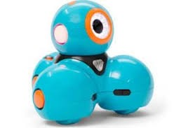





COMPETITION
Low Cost
Cue Robot
Minecraft
Morphbots®
Finch Robot 2.0
Hard to Use
Easy to Use
Mindstorms EV3
Modular Robotics
V5 Classroom Starter Kit
High Cost

Slide 8
GO-TO-MARKET
Customer acquisition will come from two strategies—direct sales: door knocking, physical presentations, and online presentations. The second strategy will be from online sales: Google ads, SEO to website, social media (Facebook, LinkedIn, and Twitter).
The TAM for the global Educational Games market is $88.11 billion 2027(F)
A major public relations strategy will be used to help market Morphbots as a leader in robotics education. Media relations, public speaking events, exclusive networking group, and a loyalty campaign will market Morphbots as the gamechanger in robotics education.
Our SAM is $4.1billion 2025(F) for US K12 Educational Based video games
Our SOM is $615 million for the NorthEast US K12 Educational Based video games

Slide 9
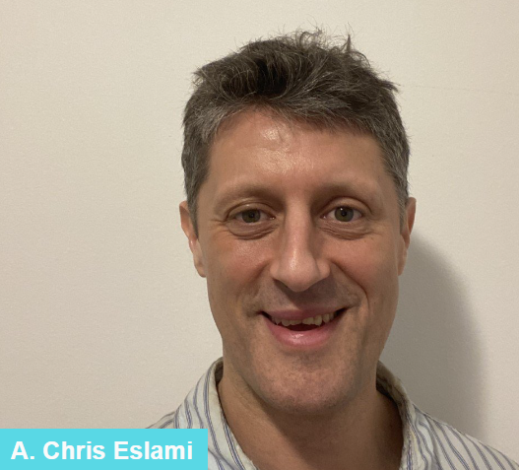

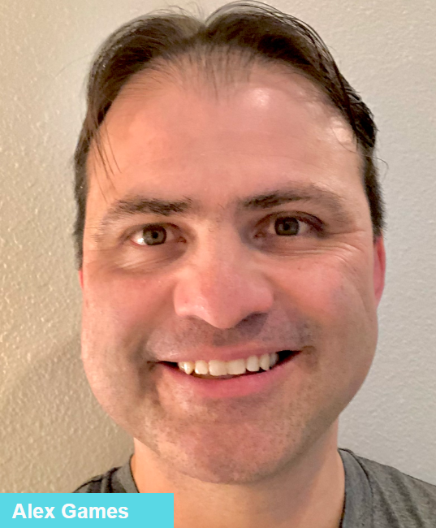

TEAM
As the CEO of Morphbots, Chris is a selling machine that believes education is the key.
Alan is the CTO of Morphbots. In his last startup, Voxon, he created a 3-dimensional display that are sold around the world in educational settings.
Alex is the Playful Learning Science Advisor. He designed the Gamestar Mechanic video game that teaches K12 students how to develop their own video games.
Sudarshan is the Business Advisor of Morphbots. He brings experience with robotics with his own robotics company Coboticca.

Slide 10
FINANCIAL PROJECTION MODEL
Financials
Monthly Analysis | Month 1 | Month 2 | Month 3 | Month 4 | Month 5 | Month 6 | Month 7 | Month 8 | Month 9 | Month 10 | Month 11 | Month 12 | Month 13 | Month 14 | Month 15 | Month 16
Total Revenue | 3,999 | 19,998 | 31,996 | 51,994 | 70,551 | 43,275 | 43,035 | 41,995 | 25,997 | 31,996 | 22,397 | 34,636 | 65,672 | 89,749 | 123,585 | 190,696
Profit/Loss | $389 | $11,748 | $18,796 | $30,544 | $41,445 | $25,422 | $25,281 | $24,670 | $15,272 | $18,796 | $13,157 | $20,347 | $38,579 | $52,723 | $72,600 | $112,024
Assumptions
We raise funds in January 2023
Projections begin 2 months after raising $500K
We are selling 3 services (remote lab, video game, kits)
We have productized the Breadboard Game
We have productized the remote lab

Slide 11




ASK
$500,000
We are asking for $500k for a 15% equity stake to finish developing the Breadboard Game, buy wholesale robotic kit material, and hire key staff for a 1-year run
Product Development $200k
New Hires $200k
Buy Robotic Kits $50k
Marketing & Sales $50k

Slide 12
THANK YOU!
CONTACT US
A. Chris Eslami
646.703.1699 Brooklyn, NY
chriseslami@selfassemblingsystems.com

